Slide 1
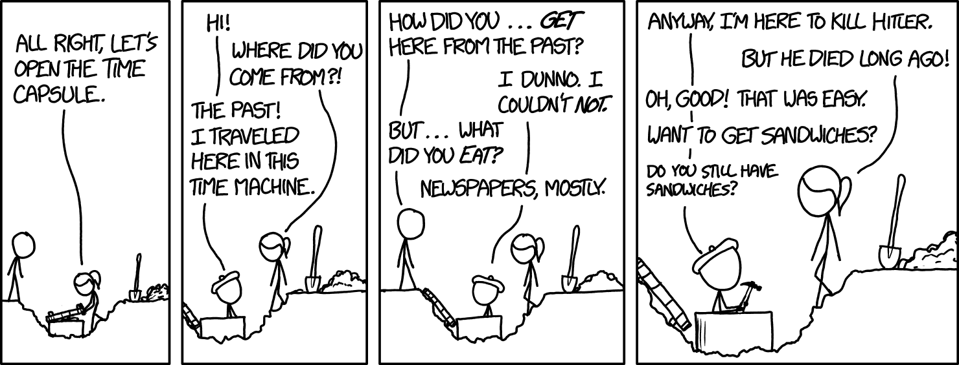
...the closest thing to a comic about capsule nets

Slide 2
CIS 700-004: Lecture 5W
Problems with CNNs and recent innovations
2/13/19
Notes:
Done

Slide 3
Problems with CNNs and recent innovations

Slide 4
Today's Agenda
Good inductive biases
The capsule nets architecture
The dynamic routing algorithm
Capsule nets in PyTorch
Resnets

Slide 5
Motivating better architectures

Slide 6
Local translational invariance is bad

Slide 7
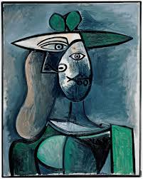
The Picasso problem
The Picasso problem - the object is more than the sum of its parts
Notes:
Silicon valley reference -- food from many angles

Slide 8
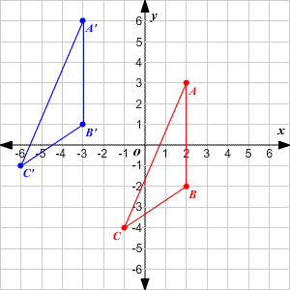
Equivariance rather than invariance
We want equivariants: properties that change predictably under transformation.
Notes:
Silicon valley reference, but globally we want invariance!

Slide 9
2. Human perception

Slide 10
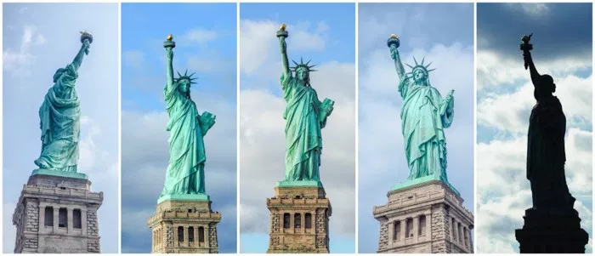
There are many aspects of pose (vector).
Pose: collection of spatially equivariant properties
Translation
Rotation
Scale
Reflection
In today's context, includes non-spatial features
Color
Illumination

Slide 11
Humans may use a mental coordinate frame for pose.
Geoffrey Hinton's motivation:
https://youtu.be/rTawFwUvnLE?t=835

Slide 12
3. Objects and their parts

Slide 13
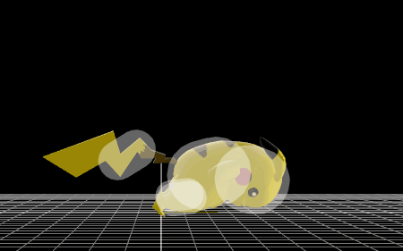
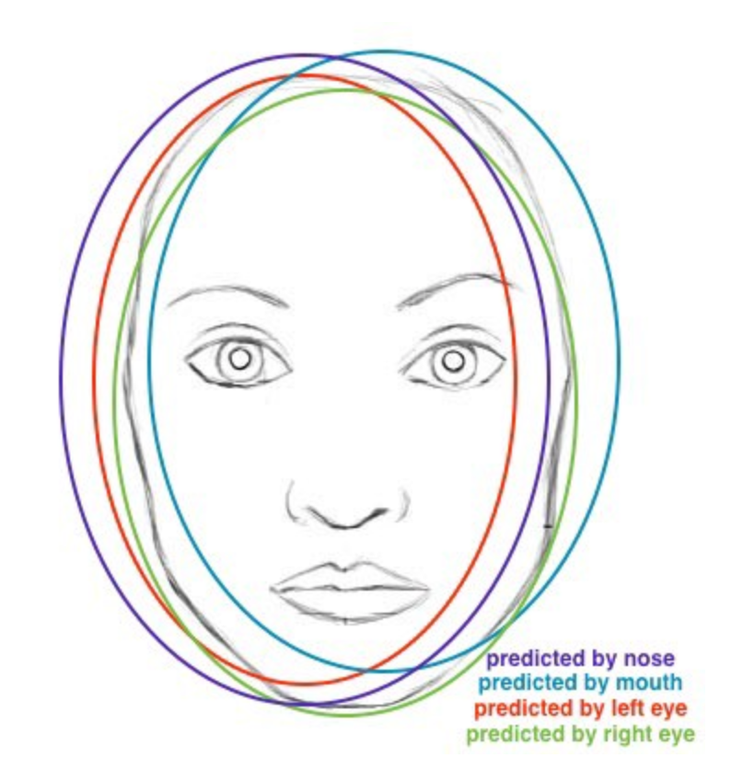
Inverse graphics: spatiotemporal continuity
Hinton's motivation:
https://youtu.be/rTawFwUvnLE?t=1265

Slide 14
4. Routing: reusing knowledge.

Slide 15
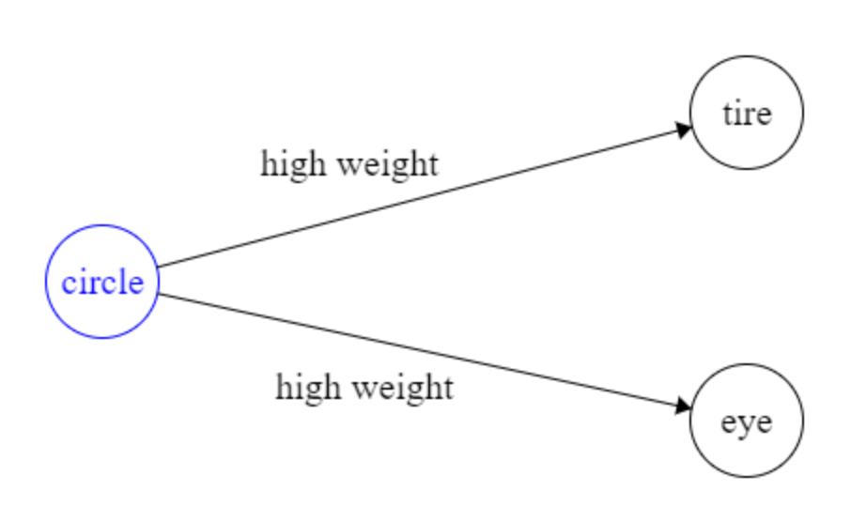
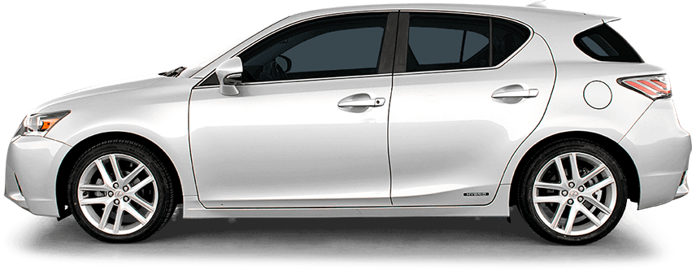
What we want: intelligent routing
We would like the forward pass to be dynamic.
Lower-level neurons should be able to predict higher-level neurons (a bit).

Slide 16
What max pooling does instead
Dynamically routes … the loudest activation in a region.
Ensure that information about exact localization is erased.

Slide 17
“The pooling operation used in convolutional neural networks is a big mistake and the fact that it works so well is a disaster.”
-- Geoffrey Hinton

Slide 18
Given all these opportunities to improve CNNs, what might we hope for from a superior architecture?

Slide 19
Our wishlist for a new architecture
Awesome priors
Translational equivariance
Hierarchical composition: the world is made up of objects that have properties.
Inverse-graphics: objects move linearly in space (translation) and rotate.
Information is properly routed to the appropriate neurons.
Routes by "agreement" rather than by "volume."
Interpretable
Clear representation of learned features
Visualization of internal representation
Learns with very few examples (fewer than 5 per class?)
Outperforms CNNs in accuracy
Runs blazingly fast
Notes:
hierarchy

Slide 20
What capsule nets give us
Awesome priors
Translational equivariance
Hierarchical composition: the world is made up of objects that have properties.
Inverse-graphics: objects move linearly in space (translation) and rotate.
Information is properly routed to the appropriate neurons.
Routes by "agreement" rather than by "volume."
Interpretable
Clear representation of learned features
Visualization of internal representation
Learns with very few examples (fewer than 5 per class?)
Outperforms CNNs in accuracy
Runs blazingly fast

Slide 21
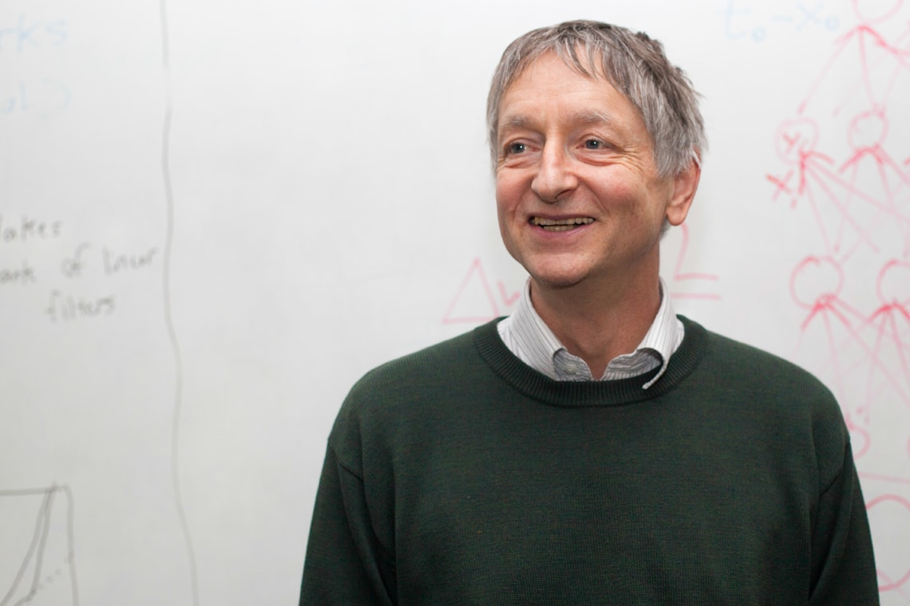
Geoffrey Hinton
English-Canadian cognitive psychologist and computer scientist
Popularized backpropagation
The "Godfather of Deep Learning"
Co-invented Boltzmann machines
Contributed to AlexNet
Advised Yann LeCunn, Ilya Sutskever, Radford Neal, Brendan Frey
Creator of capsule nets

Slide 22
The architecture of capsule nets

Slide 23
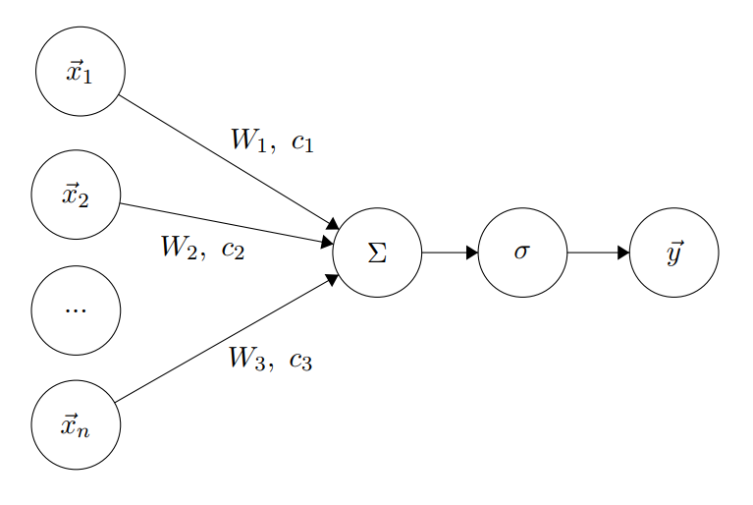
What are capsules?

Slide 24
What are capsules?
Capsules generalize the concept of neurons.
Neurons map from a vector of scalars to a single scalar output.
Capsules map from a vector of vectors to a vector output.

Slide 25
What are capsules?
Capsules generalize the concept of neurons.
Neurons map from a vector of scalars to a single scalar output.
Capsules map from a vector of vectors to a vector output.
A capsule semantically represents a feature.
The vector output length is the probability that the feature is present in the input.
The vector output direction encodes the properties of the feature.

Slide 26
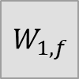
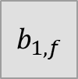
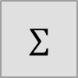
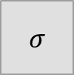
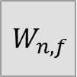
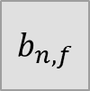
Anatomy of a capsule f for faces
Affine transform
Prior probabilities
Feature 1
…
…
Feature n
(Nose)
Static weight
Dynamic weight
Intermediate output
Relates typical nose location to face location
Estimated probability that noses relate to faces
Notes:
pos phrasing

Slide 27
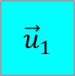
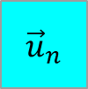
Anatomy of a capsule f for faces
Affine transform
Prior probabilities
Input
Feature 1
…
…
Feature n
(Nose)
Static weight
Dynamic weight
Intermediate output
Feature vector of nosiness

Slide 28
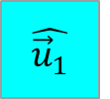
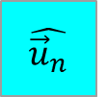
Anatomy of a capsule f for faces
Affine transform
Prior probabilities
Input
*
Feature 1
…
…
*
Feature n
(Nose)
Static weight
Dynamic weight
Intermediate output
Nose feature's estimate for what the face should be like

Slide 29
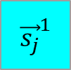
Anatomy of a capsule f for faces
Affine transform
Prior probabilities
Input
*
*
Feature 1
…
…
*
*
Feature n
(Nose)
Static weight
Dynamic weight
Intermediate output

Slide 30
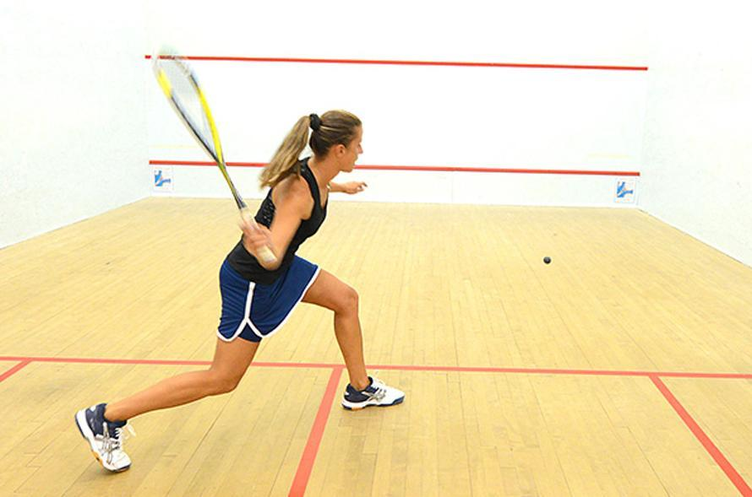
Our nonlinearity σ: the squash function
Notes:
Ask what we'd like to see from the nonlinearity

Slide 31
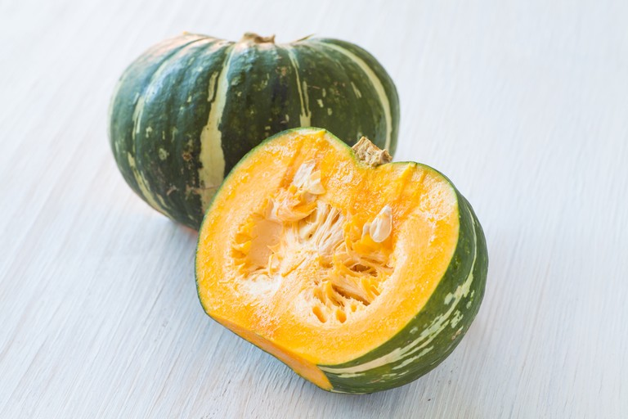
Our nonlinearity σ: the squash function
Notes:
Ask what we'd like to see from the nonlinearity

Slide 32
Our nonlinearity σ: the squash function
Recall: each capsule’s output semantically represents a feature
Vector length is the probability of the feature being in the input.
Vector direction encodes properties of the features
Notes:
Ask what we'd like to see from the nonlinearity

Slide 33
Our nonlinearity σ: the squash function
Recall: each capsule’s output semantically represents a feature
Vector length is the probability of the feature being in the input.
Vector direction encodes properties of the features
We would like to bound the range of the output to [0, 1].

Slide 34
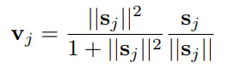
Our nonlinearity σ: the squash function
Recall: each capsule’s output semantically represents a feature
Vector length is the probability of the feature being in the input.
Vector direction encodes properties of the features
We would like to bound the range of the output to [0, 1].
Scaling factor
Unit vector

Slide 35
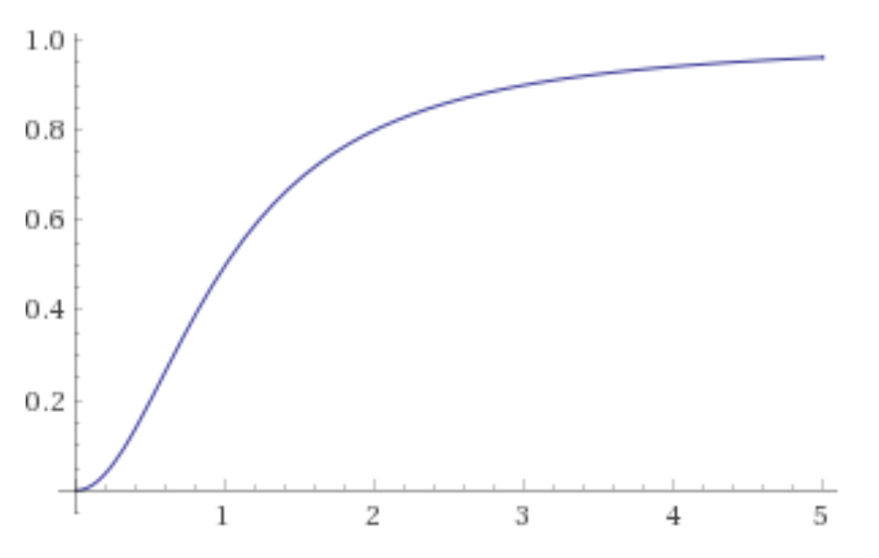
Our nonlinearity σ: the squash function
Recall: each capsule’s output semantically represents a feature
Vector length is the probability of the feature being in the input.
Vector direction encodes properties of the features
We would like to bound the range of the output to [0, 1].
Scaling factor
Unit vector

Slide 36
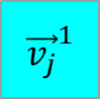
Anatomy of a capsule f for faces
Affine transform
Prior probabilities
Input
*
*
Feature 1
Output
(Iteration 1)
…
…
*
*
Feature n
(Nose)
Static weight
Dynamic weight
Intermediate output

Slide 37
Goal of routing by agreement

Slide 38
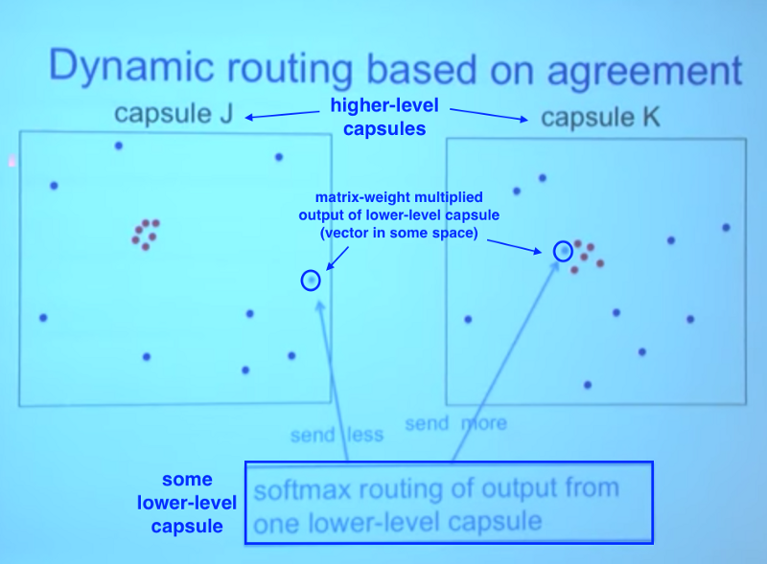
Routing between capsules (v1)
Clusters are a powerful signal in high dimensions.
How might we detect clusters in the forward pass?

Slide 39
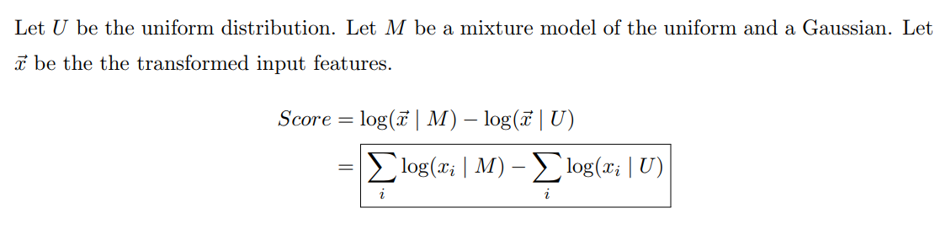
Routing between capsules (v1)
Hinton's visualization
https://youtu.be/rTawFwUvnLE?t=3106

Slide 40
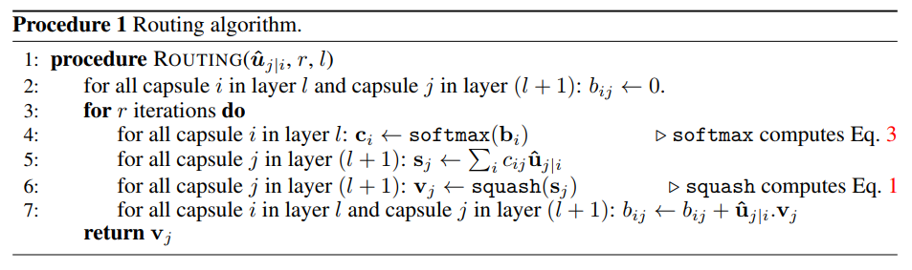
Routing between capsules (v2): dynamic routing

Slide 41
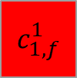
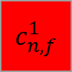
Anatomy of a capsule f for faces
Affine transform
Posterior probabilities
Input
*
*
Feature 1
Output
(Iteration 1)
…
…
*
*
Feature n
(Nose)
Static weight
Dynamic weight
Intermediate output

Slide 42
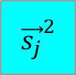
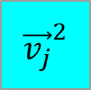
Anatomy of a capsule f for faces
Affine transform
Posterior probabilities
Input
*
*
Feature 1
Output
(Iteration 2)
…
…
*
*
Feature n
(Nose)
Static weight
Dynamic weight
Intermediate output

Slide 43
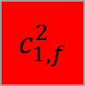
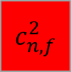
Anatomy of a capsule f for faces
Affine transform
Posterior probabilities
Input
*
*
Feature 1
Output
(Iteration 2)
…
…
*
*
Feature n
(Nose)
Static weight
Dynamic weight
Intermediate output

Slide 44
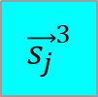
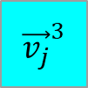
Anatomy of a capsule f for faces
Affine transform
Posterior probabilities
Input
*
*
Feature 1
Output
(Iteration 2)
…
…
*
*
Feature n
(Nose)
Static weight
Dynamic weight
Intermediate output

Slide 45

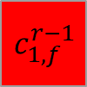
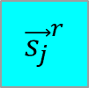
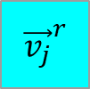
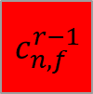
Anatomy of a capsule f for faces
After r iterations…
Affine transform
Posterior probabilities
Input
*
*
Feature 1
Output
(Iteration r)
…
…
*
*
Feature n
(Nose)
Final face feature
Notes:
*
*

Slide 46
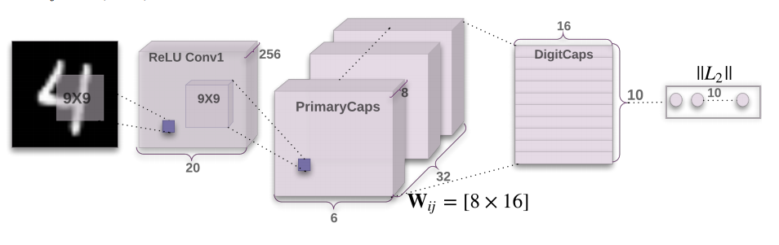
The overall capsule net architecture
Notes:
olshausen vanessen dynamic routing

Slide 47
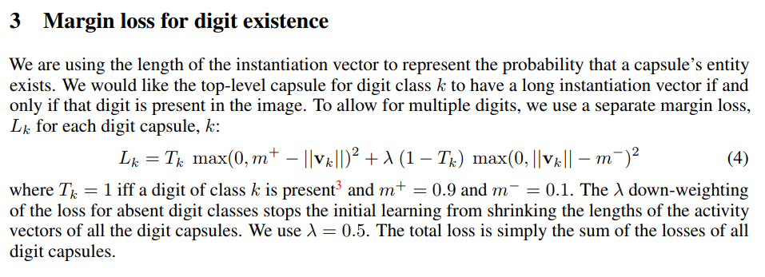
Margin loss

Slide 48
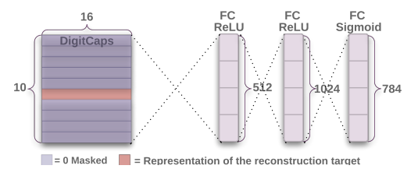
Reconstruction: visualizing the architecture's encoding

Slide 49
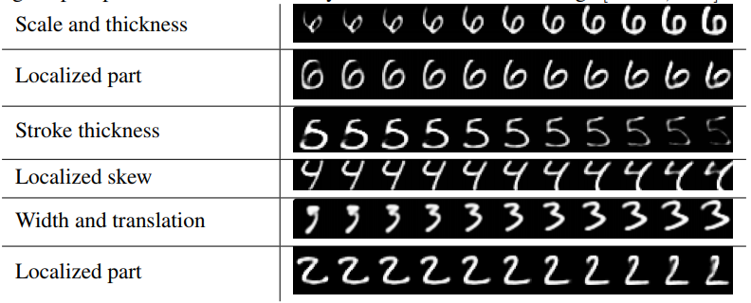
Interpretation

Slide 50
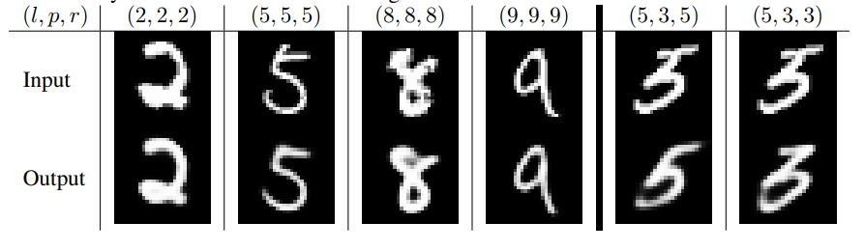
Interpreting a Mistake
Ordered triples are (true label, prediction, and reconstructed capsule)

Slide 51
Results

Slide 52
Capsule networks are state-of-the-art.
MNIST: 0.25% error (current record)
Baseline CNN: 35.4 million parameters
Capsule Net: 6.8 million parameters
Capsule nets can also get 1.75% error using only 25 labeled examples.
MultiMNIST: 5.2% error (current record)
CIFAR10: 10.6% error
smallNORB: 2.7% error (current record, tied with LeCun et. al.)
affNIST: 79% accuracy (compare to CNN with 66% accuracy)

Slide 53
Capsule nets in PyTorch
https://github.com/gram-ai/capsule-networks/blob/master/capsule_network.py

Slide 54
What capsule nets give us
Awesome priors
Translational equivariance
Hierarchical composition: the world is made up of objects that have properties.
Inverse-graphics: objects move linearly in space (translation) and rotate.
Information is properly routed to the appropriate neurons.
Routes by "agreement" rather than by "volume."
Interpretable
Clear representation of learned features
Visualization of internal representation
Learns with very few examples (fewer than 5 per class?)
Outperforms CNNs in accuracy
Runs blazingly fast

Slide 55
Takeaways from capsule nets
Thinking very carefully about your priors and biases can inform good architecture choices and lead to very good results.
Interpretability is credibility for neural nets.
This is probably the gold standard.
Geoffrey Hinton is a badass.

Slide 56
A different problem: depth

Slide 57
Is depth good?
Deeper networks can express more functions
Biased towards learning the functions we want
Hard to train
E.g. exploding / vanishing gradients
Deep learning => deeper nets, harder computations
Can we have very deep networks that are easy to train?

Slide 58
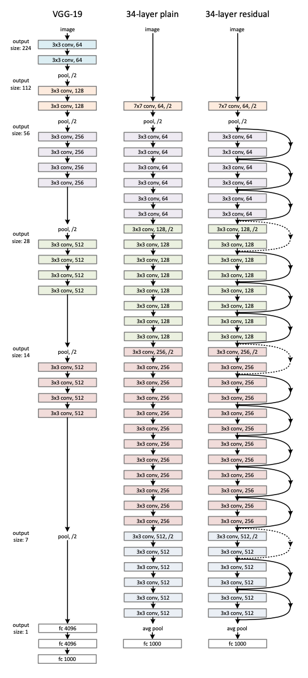
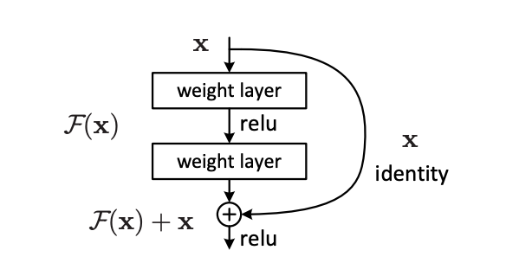
ResNets
Residual networks (ResNets): skip connections between non-consecutive layers

Slide 59
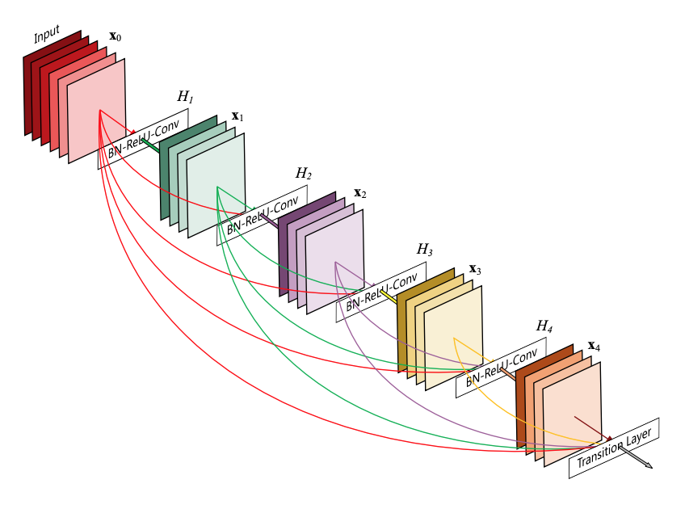
DenseNets
If skip connections are a good thing, why don’t we do ALL of them?

Slide 60
Question
Are there functions that can be computed by a ResNet but not by a normal deep net?
No! ResNets represent an inductive bias rather than greater expressive power.

Slide 61
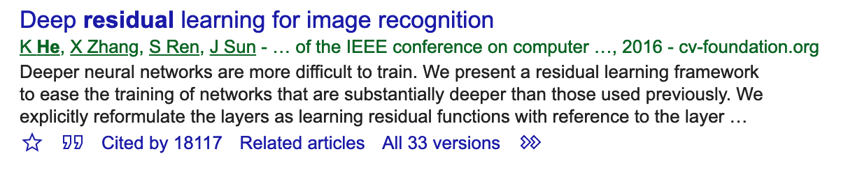


Results

Slide 62

ResNets act like ensembles of shallow nets
Veit et al. (2016)

Slide 63

Deleting layers doesn’t kill performance
Veit et al. (2016)

Slide 64

Loss landscapes
Li et al. (2018)

